Slide 1
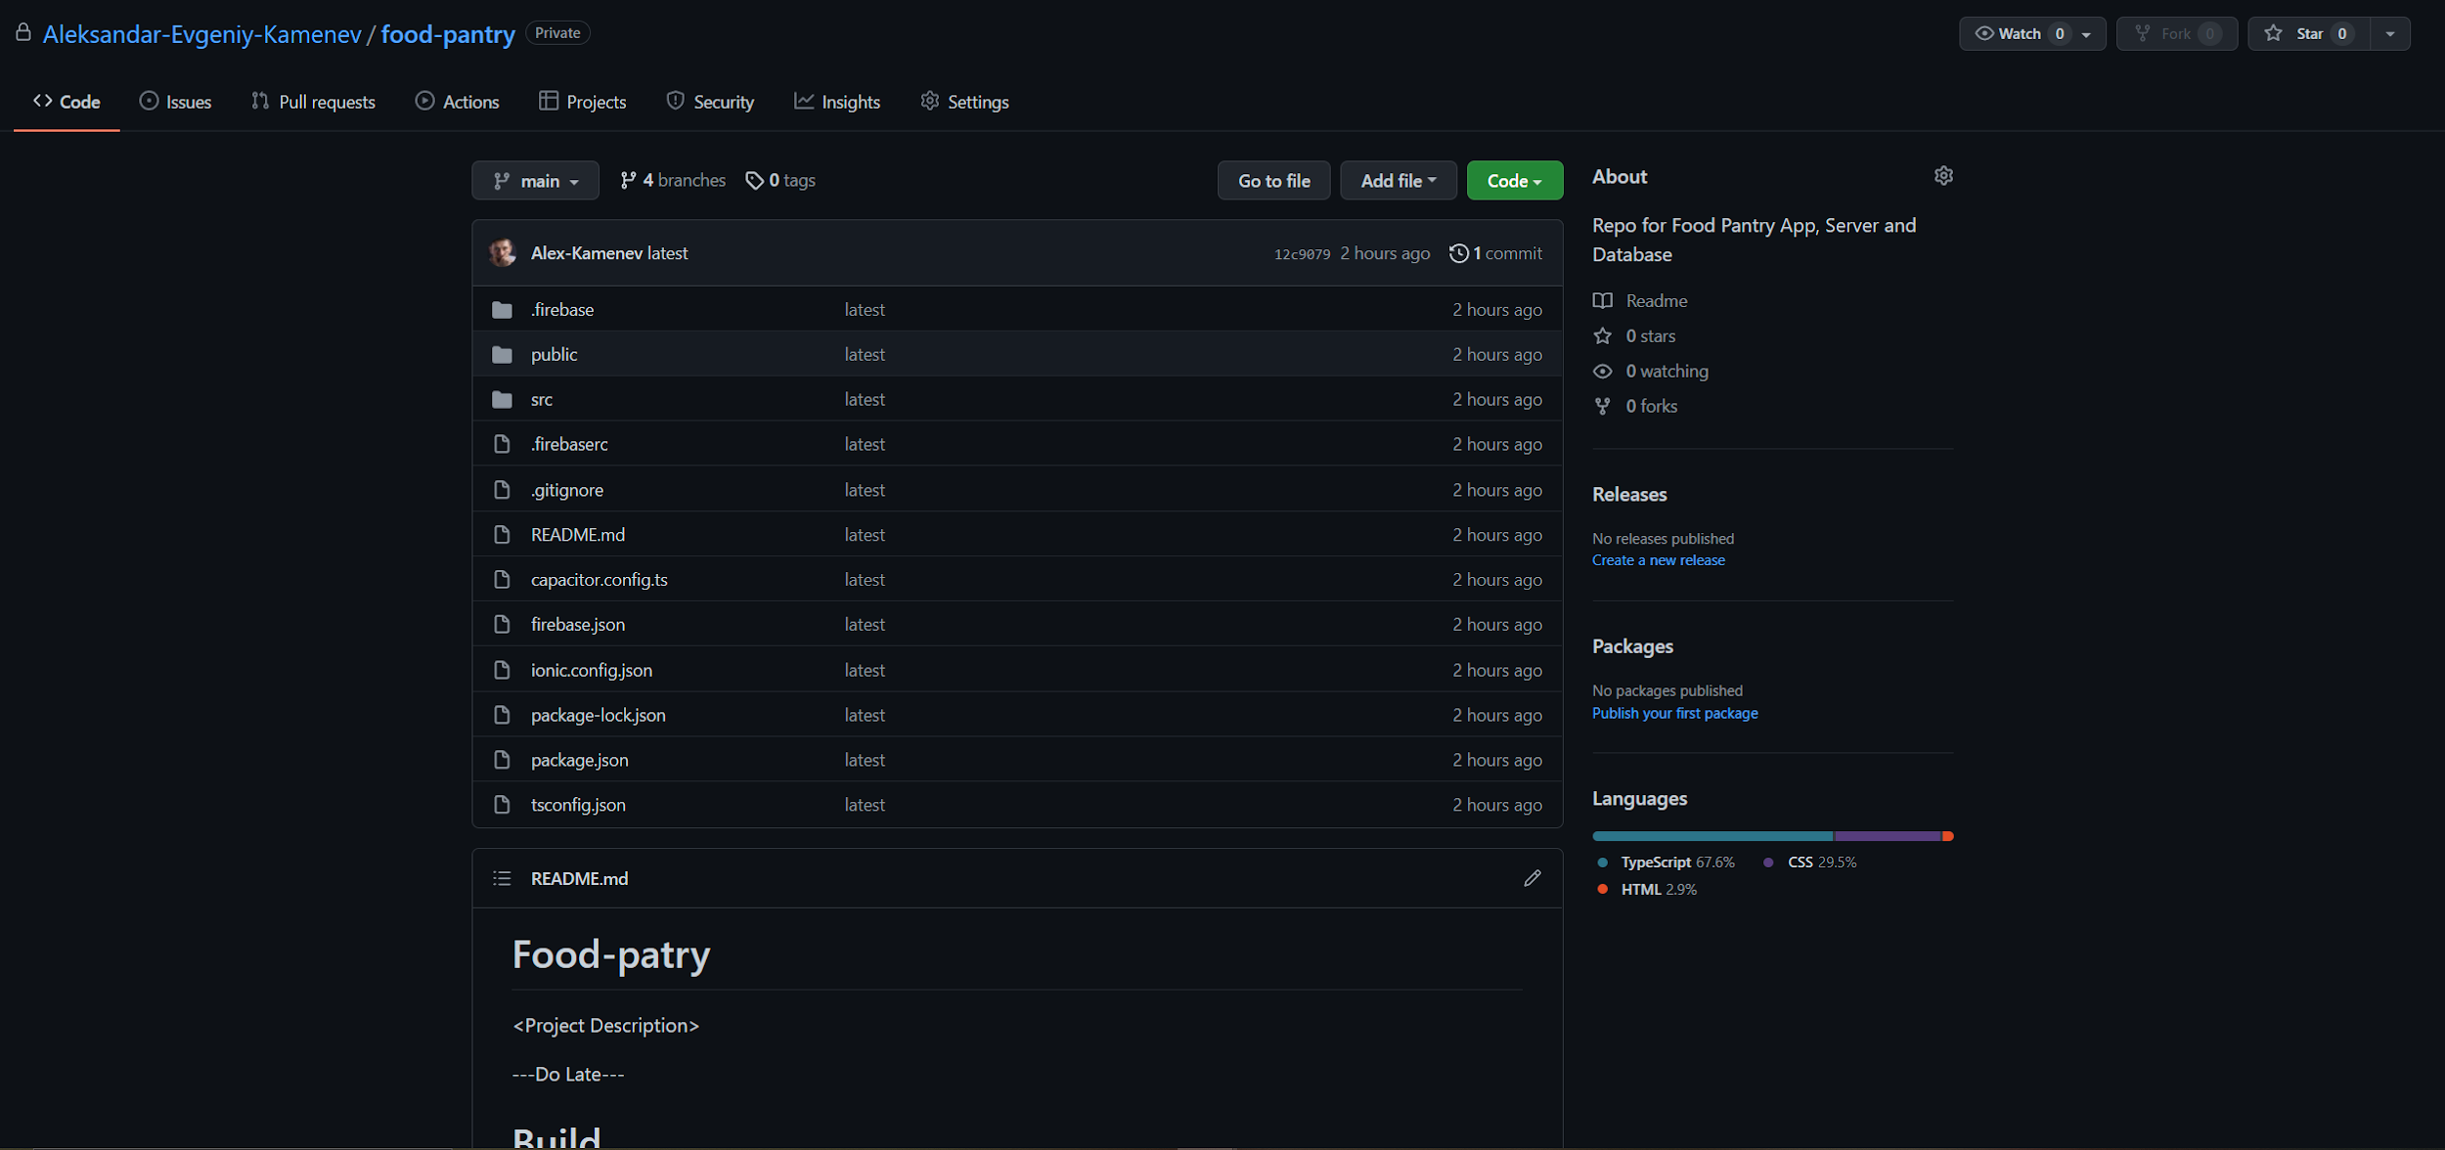
GitHub Repo
https://github.com/Aleksandar-Evgeniy-Kamenev/food-pantry

Slide 2
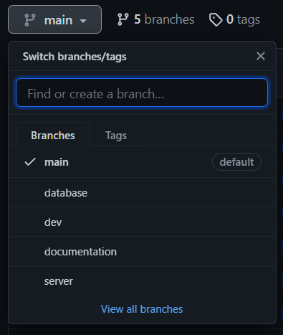
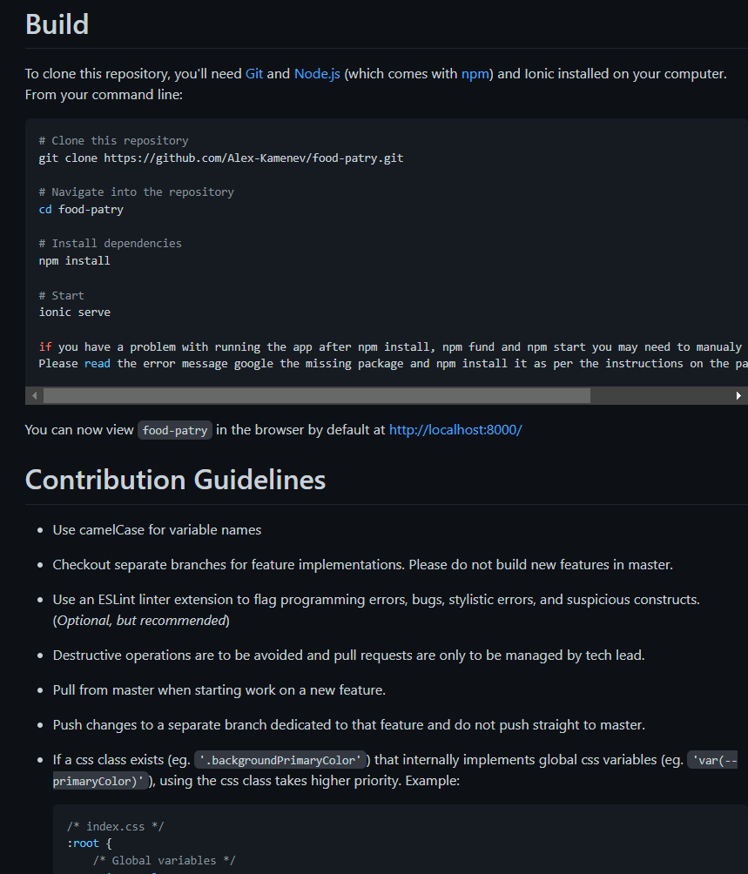
GitHub Repo Structure

Slide 3

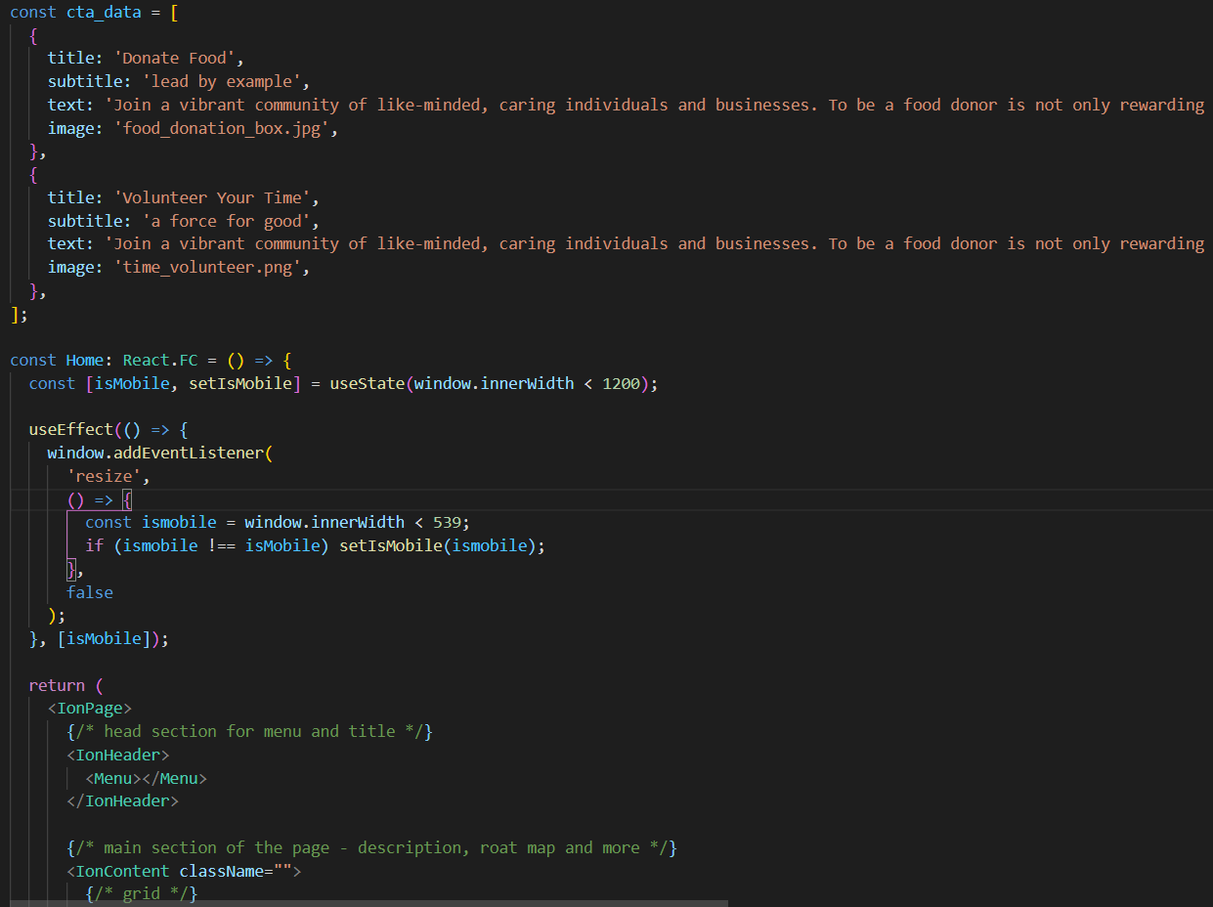
Code Snippet

Slide 4
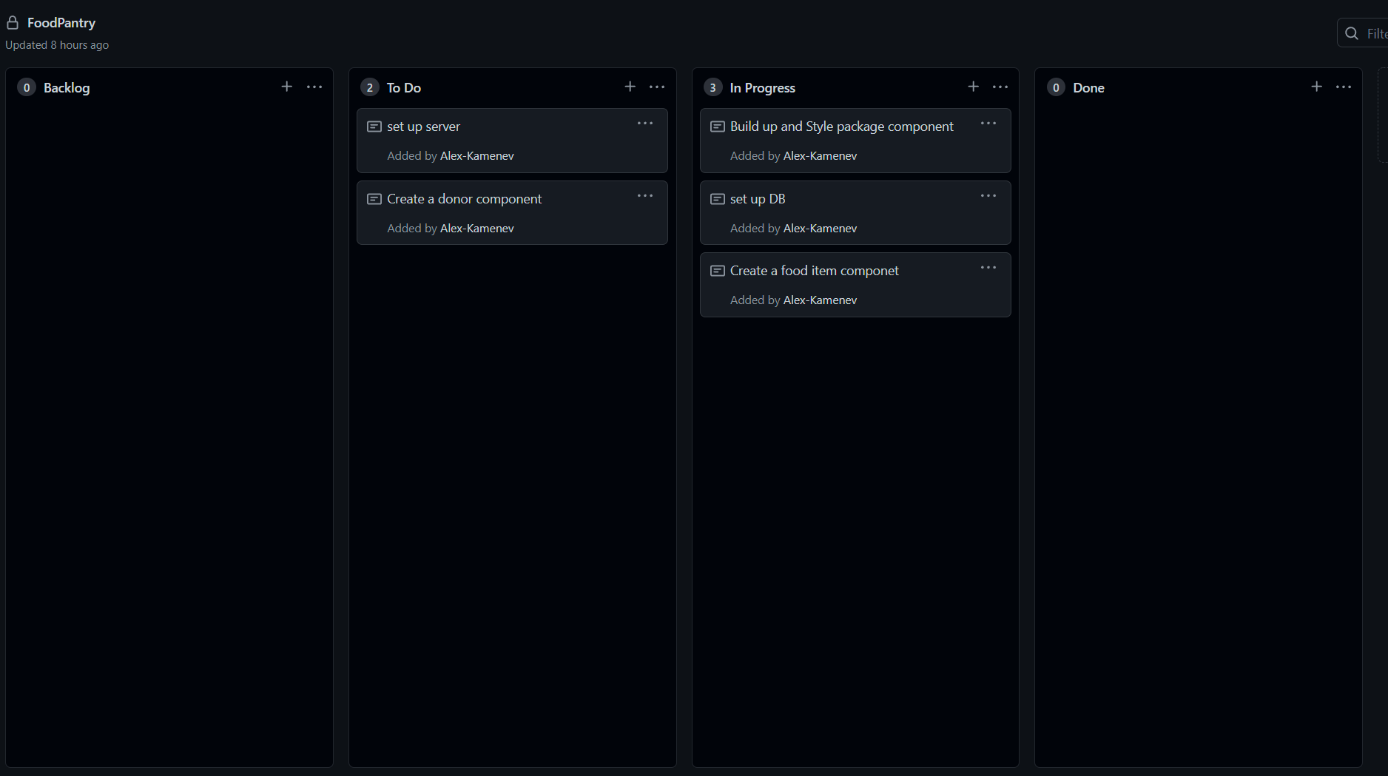
Kanban Board

